Slide 1
Broadcast FM DX
Russ Edmunds
WB2BJH

Slide 2
TYPES OF STATIONS
“Standard” stations
Commercial : 92.1 – 107.9 mHz
Educational/Non-Commercial : 88.1 – 91.9 mHz
Translators – rebroadcast any of the above
Low Power – “community stations”
Pirates / Part 15’s

Slide 3
Receivers
AM-FM or FM Stereo Tuners or Receivers
Portable receivers
Automobile radios
SDR’s

Slide 4
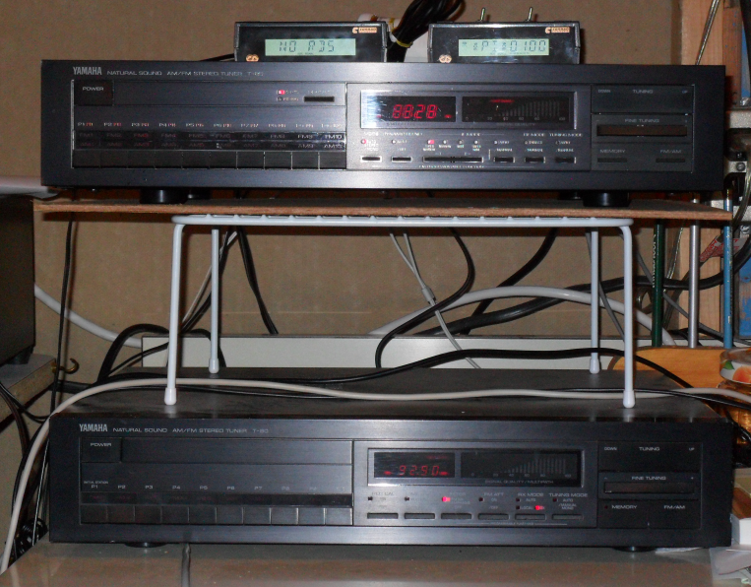
Receivers

Slide 5
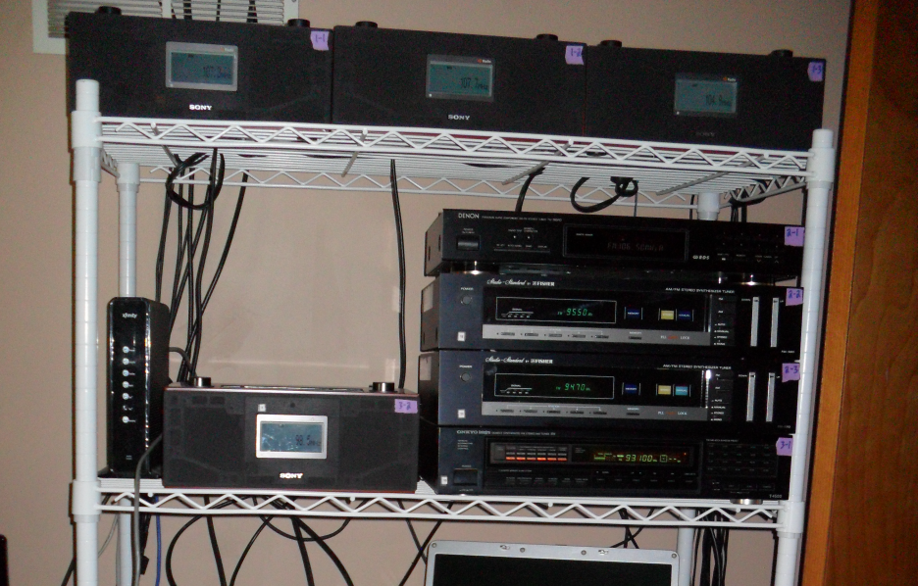
Receivers
Pic of Steve’s setup

Slide 6
Receivers
For most tuners and receivers, it will be necessary to substitute narrower IF filters to improve selectivity
This can be done by the advanced user
For best selectivity, filters in the range of 110 to 180 kHz are recommended
Most original filters are 250-280 kHz

Slide 7
Antennas
FM or TV-FM multi-element outdoor yagi
Indoor wire dipole
Nondirectional whip
Indoor “Rabbit Ears”
Car radio antenna

Slide 8
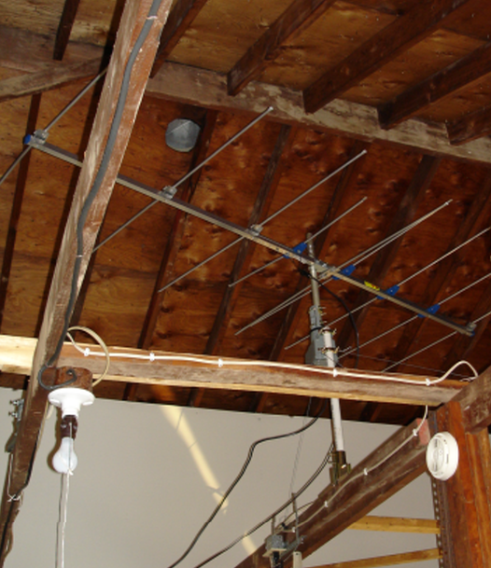
Antennas

Slide 9
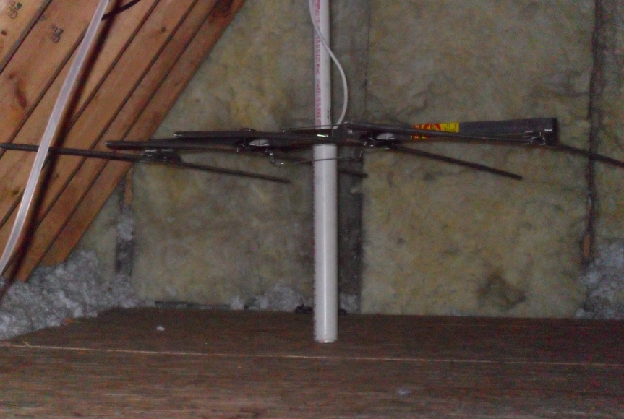
Antennas
Pics of Steve’s antennas

Slide 10
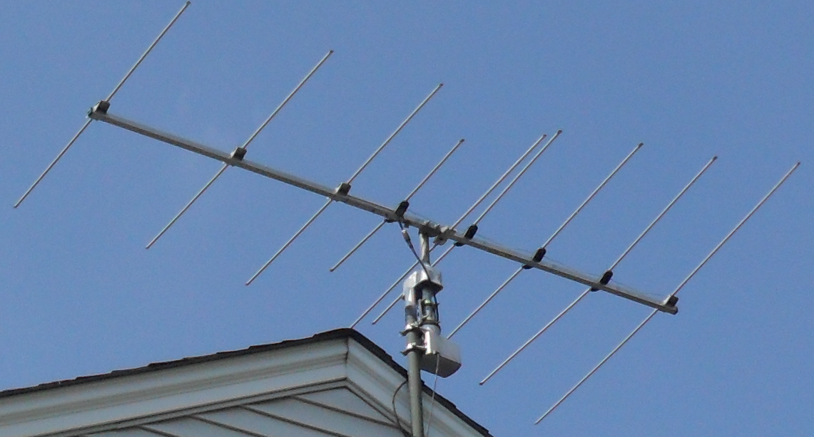
Antennas

Slide 11
Location
Elevation is generally good
Distance from powerful signals is better
Shorelines ( including lakes ) can provide signals on lower loss paths across water
Horizon blockage – mountains, cliffs, valleys, buildings, towers – is to be avoided

Slide 12
RDS/RDBS
Radio Data (Broadcast) Service
Transmits data along with audio
Requires specific decoder & software
Included in some SDR’s & tuners
Now available on many car radios
May transmit calls, slogan, music title, artist, news, weather, traffic.

Slide 13
RDS/RDBS
Code matrix includes a unique identifier ( PI Code ) which is keyed to call letters
Some stations, particularly iHeart, alter these codes for proprietary reasons
Some stations don’t reset codes so data is wrong
Not all stations transmit RDS

Slide 14
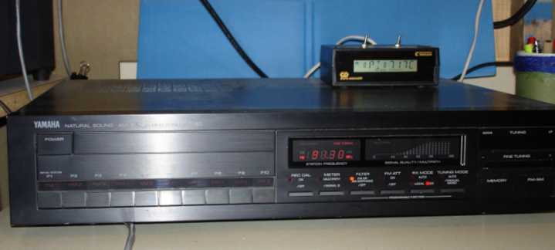
RDS/RBDS
Pic of my setup

Slide 15
RDS/RDBS

Slide 16
RDS/RDBS

Slide 17
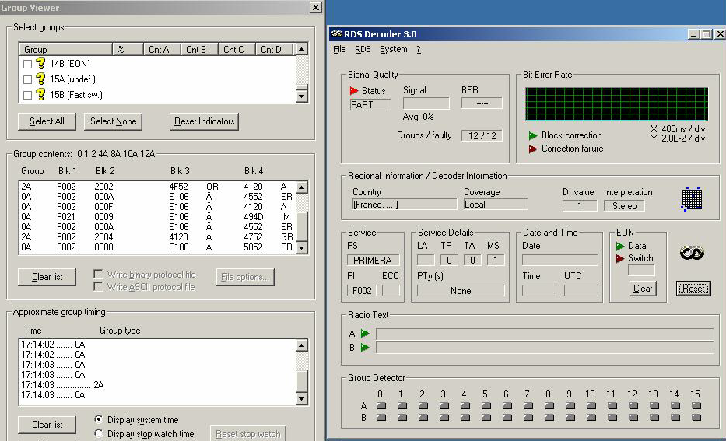
RDS/RDBS
Screen print of RDS Software

Slide 18
RDS/RDBS

Slide 19
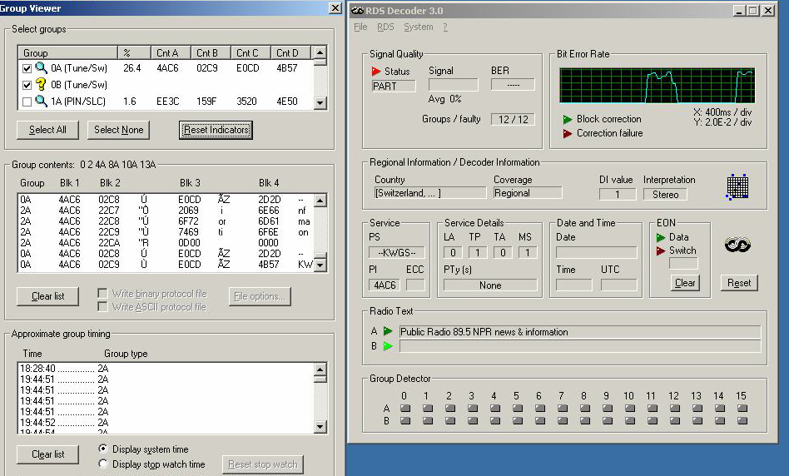
RDS/RDBS
Software display including all elements

Slide 20
RDS/RDBS

Slide 21
RDS-RDBS via SDR

Slide 22
RDS-RDBS via SDR

Slide 23
Recording
Recording software on computer
Recording via SDR
Portable or fixed recording devices

Slide 24
Propagation Modes
“Normal” conditions - Groundwave
Troposcatter
Tropospheric Ducting
Sporadic E Skip
Meteor Scatter
Aurora
All non-normal modes depend on refraction

Slide 25
Propagation Modes

Slide 26
Normal conditions - Groundwave
Propagation is Line of Sight
Due to tall transmitting towers, this is not the same as visual line-of-sight
Average distance depends on terrain, other blockage, station power & antenna height
Typically 0 -125 miles in the Northeast US; 300+ miles in the West

Slide 27
Troposcatter
An unstable, unpredictable mode which can provide extended distance
Signals are often unstable
Typically up to about 250 miles
To some degree, present much of the time
Created by small changes in the refractive index temperature differences in the atmosphere

Slide 28
Tropospheric Ducting
Weather related – temperature inversions
Can provide unstable to solid signals for extended periods of time up to several days
May be almost omnidirectional or highly directional
More distant signals can override locals
Can extend hundreds or thousands of miles

Slide 29
Tropospheric Ducting

Slide 30
Tropospheric Ducting

Slide 31
Tropospheric Ducting

Slide 32
Tropospheric Ducting
CIDC 103.5
WOSU 89.7
WCPE 89.7
WKSU 89.7

Slide 33
Sporadic E Skip
Causes are not fully known and under debate
Both geomagnetic and meteorological elements
Highly energized patches ( or clouds ) in the E layer
More prevalent between late May and mid-August in much of the US
Can be highly directional or multi-directional

Slide 34
Sporadic E Skip

Slide 35
Sporadic E Skip
Single hop can range from about 500 to about 1500 miles
Average single hop distance is 900-1000 miles
Double hop can reach between 2400 - 3000 miles
Average double hop distance runs between 2000 and 2500 miles

Slide 36
Sporadic E Skip

Slide 37
Sporadic E Skip

Slide 38
Sporadic E Skip
Subject to a Maximum Usable Frequency ( MUF ) where skip exists below the MUF but signals are not reflected above the MUF
The MUF can vary within events - skip can appear to drop out only to return – don’t give up too soon
Multiple clouds can have differing MUF’s

Slide 39
Sporadic E Skip
Sporadic E clouds are mobile relative to the earth’s surface so the geography can change over time during events – with the skip area often moving West or Northwest
Some events are coincident with strong frontal systems moving generally west to east across North America
Multiple clouds – different directions

Slide 40
Sporadic E Skip – 6/23/15

Slide 41
Sporadic E Skip – 8/11/15

Slide 42
Sporadic E Skip – 7/12/16

Slide 43
Sporadic E Skip
HIGP – 88.1
RJR – 94.9
WTPM – 92.9
ZFB – 94.9
More94 – 94.9

Slide 44
Sporadic E Skip
CFQC – 92.9
WTQT-LP – 94.9
WZRO-LP – 93.1
CITI – 92.1

Slide 45
Meteor Scatter
Signal is reflected from meteor
Signal duration is brief
Mostly during regular major meteor shower events
Distances similar to single hop Es and can be even shorter

Slide 46
Meteor Scatter
KOKX 95.3
KERX 95.3
KGRC & WRPW 92.9

Slide 47
Aurora
Occurs during periods of high geomagnetic activity
Signals are fluttery, with some buzz present, often distorted
Auroral DX will appear to come from the North, regardless of true direction of station
Typically 200-800 miles distance; max 1300
More prevalent for Northerly DX locations

Slide 48
FM DX Techniques
Monitor online maps, bulletin boards, loggers
Periodically check open or semi-open frequencies
Record heavily – if nothing develops you can easily delete recordings
Don’t ‘target’ specific stations until you’ve been DX’ing FM for a few years so as not to limit your options

Slide 49
FM DX Techniques
Determine what direction(s) DX is coming from – aim antenna that way
Unless using a highly directional antenna, your beamwidth will likely be 90-120 degrees
Have resources available to know which frequencies are available at the ‘other end’
Always re-review recordings to find what you might have missed live

Slide 50
Digital Transmission
IBOC “In Band, On Channel” Hybrid Digital/Analog Mode used in US
Digital signals ride on the sidebands of the analog signal
On an analog receiver, heard as a loud hiss on the first adjacent channels
Very few receivers available or in use
A major source of interference for FM DX

Slide 51
Digital Transmission
Much of Europe uses DRM transmission which is not transmitted within the FM band
The two systems are not compatible – neither can be received other than with their own dedicated receivers
Both Canada and Mexico have adopted compatible systems with ours but very few stations are using it as yet

Slide 52
Useful Links
Worldwide TV FM DX Association ( WTFDA )
www.wtfda.org
Tropospheric Forecast
www.dxinfocentre.com/tropo.html
Tropospheric Ducting Real Time
aprs.mountainlake.k12.mn.us

Slide 53
Useful Links
Real time maps ( Tropo, MS and Es – all VHF )
www.dxmaps.com Tvcomm.co.uk/g7izo/propagation- maps/north-america-sporadic-e
Receivers
www.fmtuners.com

Slide 54
Useful Links
FMDX generally
www.dxfm.com
Recording software for PC
www.highcriteria.com
SDR Review
www.rtl-sdr.com/roundup
-software-defined-radios/

Slide 55
Useful Links - Antennas
4-el Stellar Labs
http://www.mcmelectronics.com/product/STELLAR-LABS-30-2460-/30-2460
Korner beam
http://www.antennenland.net/3H-FM-92-shorted-Kit
Wade antennas
http://www.wadeantenna.com/product.php?p=282

Slide 56
Credits
Brett Saylor W3SWL; Nick Langan W2NJL; Steve Walko K3PHL;
Bill Nollman; Girard Westerberg
Copy of presentation: www.radiodxing.com/fm
Contact:
Russ Edmunds WB2BJH Russ@wb2bjh.com

